Slide 1
Predicting Breast Cancer
Response to Neoadjuvant Chemotherapy
Using Clinical Data & Digital Pathology AI
Team 6 :
Diana Dadkhah Tirani
Gurveer Madurai
Derrick Jaskiel
Victoria Farkas
Rachel Chiu
Nandini Krishnan

Slide 2
Background
Breast cancer is the most commonly diagnosed cancer in women globally
High-risk patients receive chemotherapy before surgery (neoadjuvant therapy) to shrink the tumor
Best outcome: pathological complete response (pCR) — no cancer remaining after treatment
Patients who achieve pCR have significantly better long-term survival
Problem: no reliable way to predict who will respond before treatment begins

Slide 3
The Question
Can we predict whether a breast cancer patient will achieve
pathological complete response (pCR) to chemotherapy
before treatment begins?
Using pre-treatment clinical data + digital pathology biopsy images
pCR predicted → Proceed with confidence
Non-pCR predicted → Switch treatment early

Slide 4
The Dataset: Data Understanding and Preprocessing
Health Data Nexus — High-Resolution Digital Pathology of Breast Cancer
157
4
31
Patients
Cancer Subtypes
Clinical Variables
Single Canadian institution, patients treated 2013-2018
Each patient: H&E whole-slide biopsy image (~60,000 x 18,000 pixels) + clinical data
Subtypes: Luminal A (40), Luminal B (39), TNBC (40), HER2+ (38)
Target: pCR (complete response) vs non-pCR (residual disease)
Features extracted from images (will touch on this later)

Slide 5
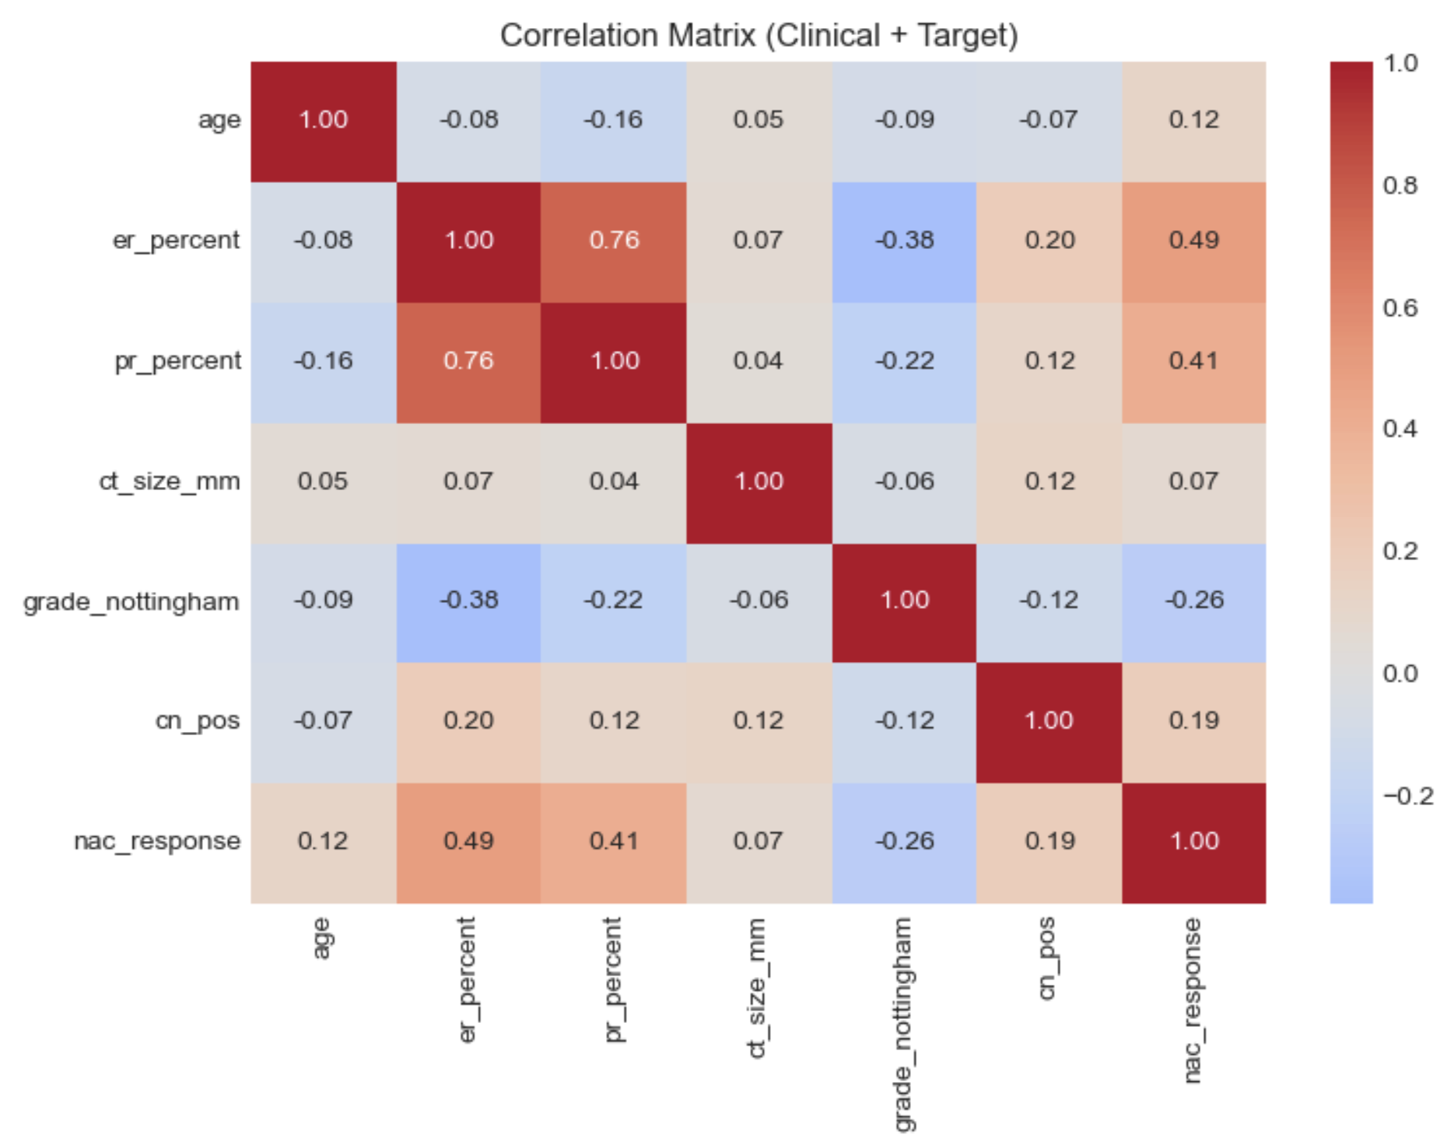
Exploratory Data Analysis: Response & Subtypes
ER% (0.49) — strongest predictor. Higher estrogen receptor = more likely to have residual disease (non-pCR)
PR% (0.41) — second strongest, same story as ER. Hormone receptor positive tumors resist chemo
Grade (-0.36) — higher grade (more aggressive) tumors actually respond better to chemo.
HER2 (-0.26) — HER2-positive patients respond better, largely because they also receive trastuzumab (targeted anti-HER2 therapy) alongside chemo
Key Insight: Luminal A = 0% pCR | HER2+ = 79% pCR — Subtype is a powerful predictor

Slide 6
Feature Selection
Features Kept
Features Dropped
ER% — strongest predictor (r=0.49)
PR% — second strongest (r=0.41)
HER2 status — strong signal
Nottingham Grade — higher = better response
Tumor size (mm) — clean, no missing
Node status — moderate signal
Age — let model decide
Histology — IDC vs ILC
Image features (6 image features)*
ER/PR binary — redundant (kept continuous %)
Subtype — derived from ER/PR/HER2 (leakage)
RCBI — this IS the outcome (cheating)
Surgery, adjuvant therapy — post-treatment
NAC regimen — treatment info, not predictive input
LVI — messy, unreliable categories
Imaging metadata — not about the patient
Notes:
To build our predictive baseline, we focused on clinical variables available at the time of diagnosis. Our goal was to eliminate 'future' information and redundant features to prevent model over-fitting

Slide 7
Methodology: Three-Phase Approach
Phase 1
Phase 2
Phase 3
Clinical Baseline
clinical base + Image features
Multimodal Fusion
8 clinical features
Logistic Regression, RF,
Gradient Boosting, SVM, XGBOOST
5-fold CV
Same model as phase 1
14 features in total
Image features are included
Clinical + Image features
Trained a custom Keras neural network
11 features
→
→
Notes:
We decided to approach the modelling in 3 phases. First we trained a set of models on JUST the tabular data. In phase 2 we took these same models and built a layer of predictability with the features we extracted from images. The third and final phase included a multimodal neural network trained on both clinical and image features

Slide 8
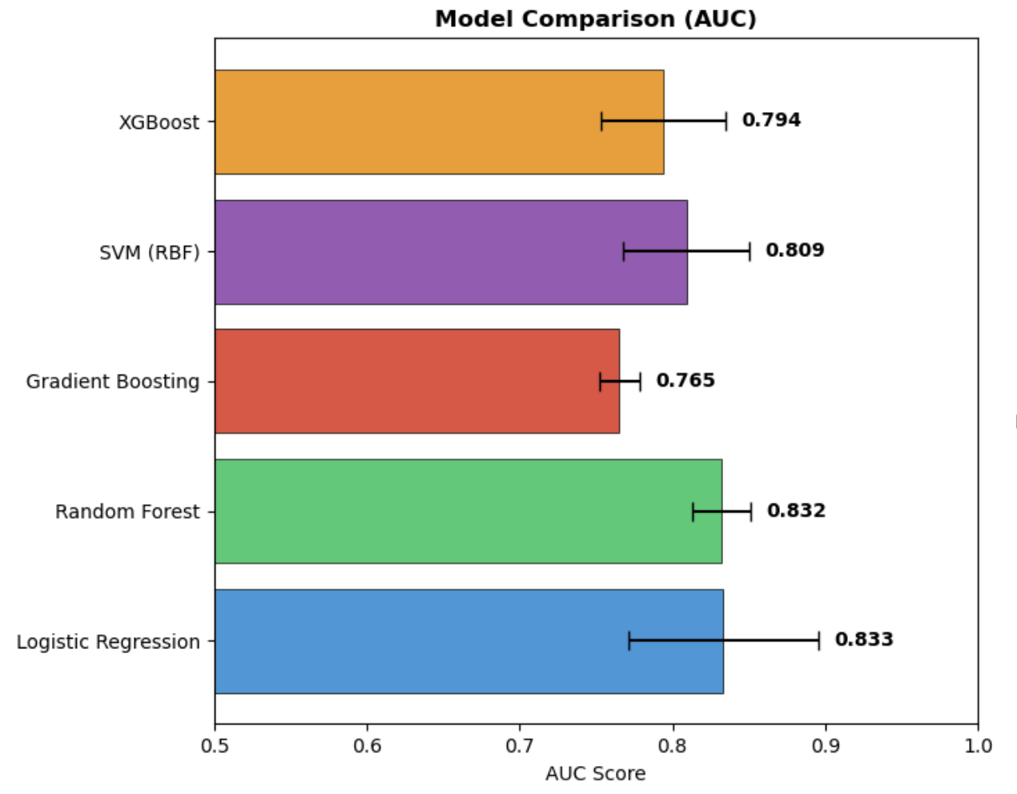
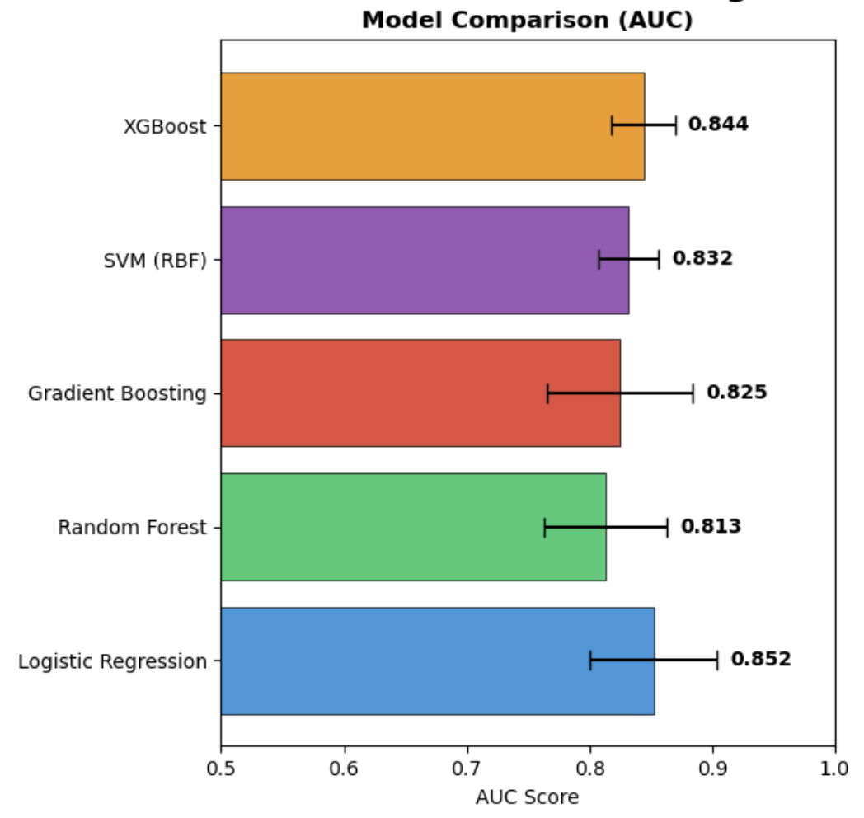
Baseline Results
Clinical Baseline (Phase 1)
Clinical + IMG Baseline (Phase 2)
Baseline established: Logistic Regression AUC = 0.852
Notes:
While we tested various methods, Logistic Regression emerged as our top-performing baseline. It achieved the highest AUC of 0.852

Slide 9
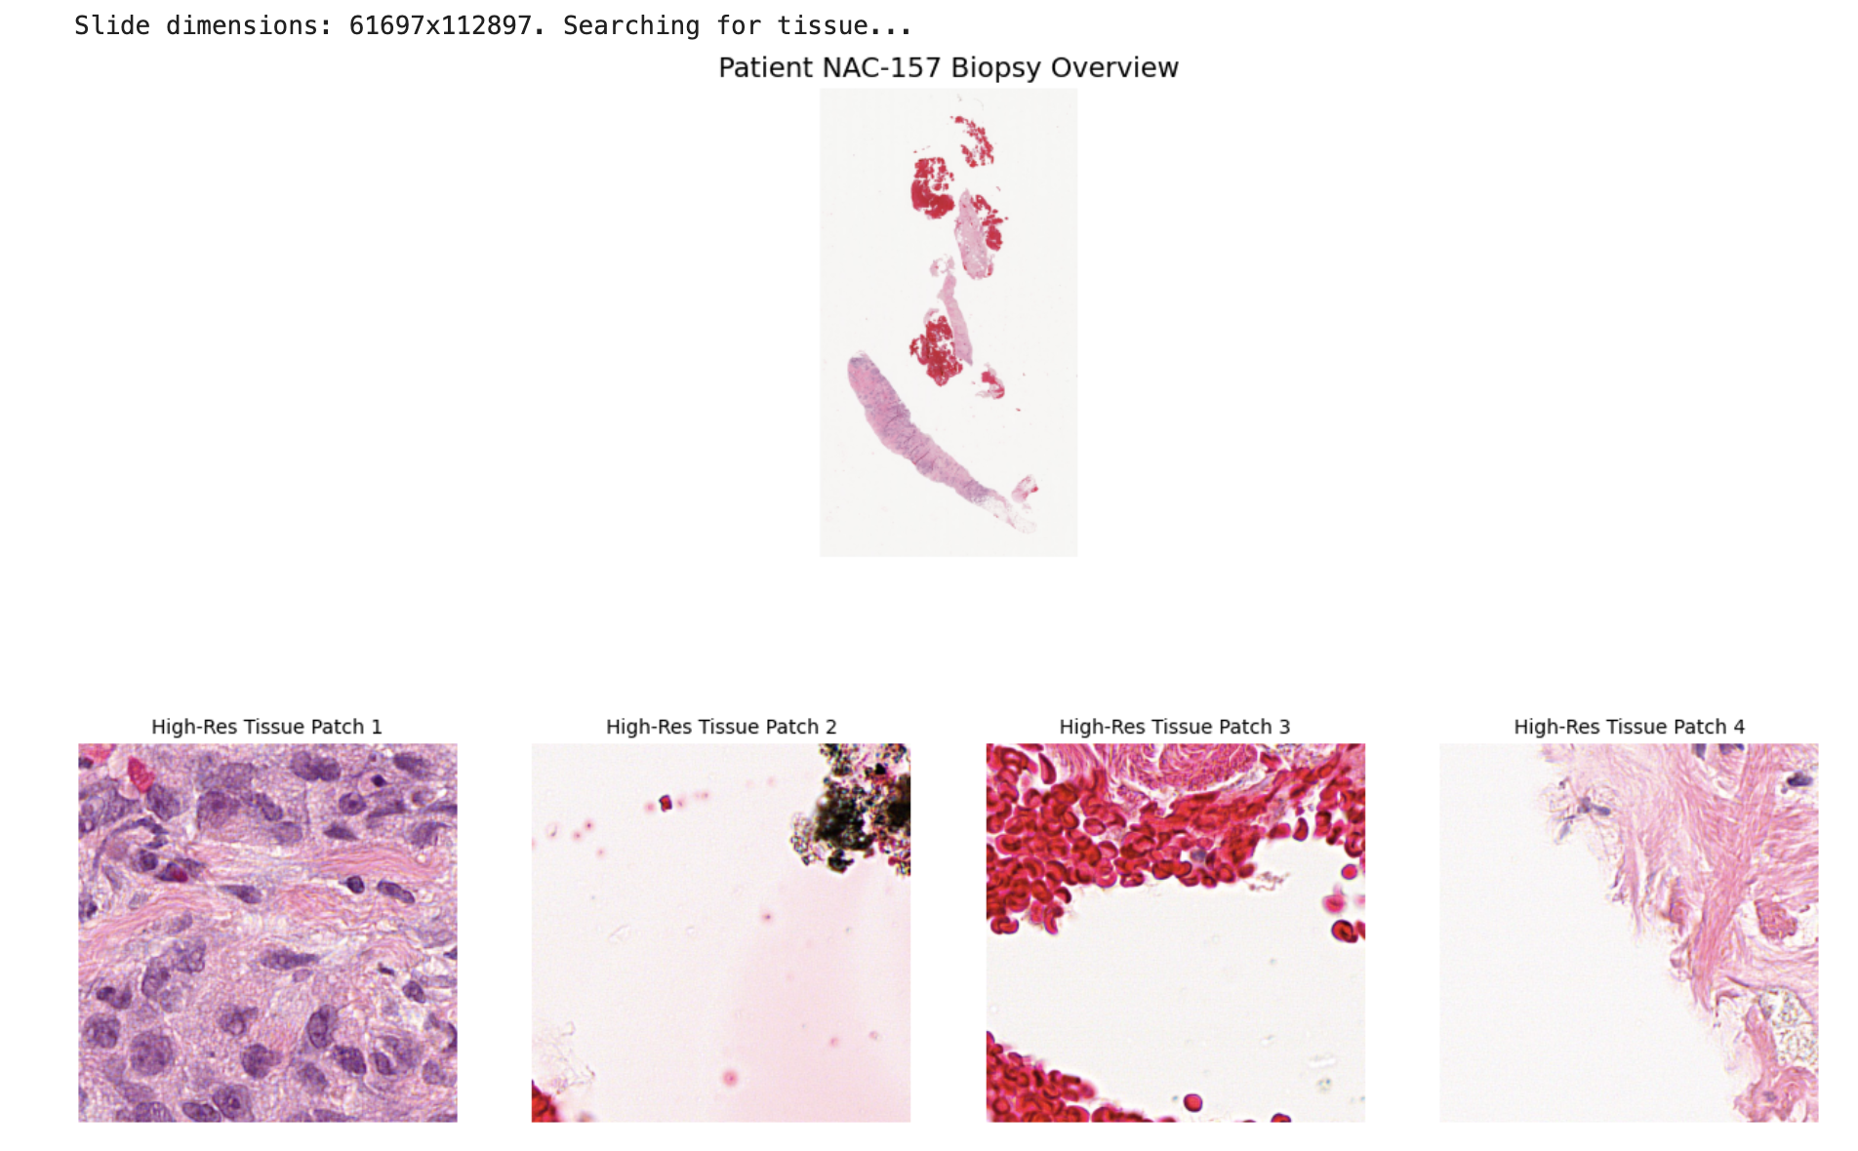
Image Feature Extraction
Whole Slide
Image
Patch
Extraction
Feature
Extraction
Aggregation
Final Output
40x magnification
Tiling necessary for processing
Tissue filtering
Max 200 patches/image
Identify edges and nuclear clumps
Average NumPy representations per patch for each image
Extract a single value per feature
→
→
→
→

Slide 10
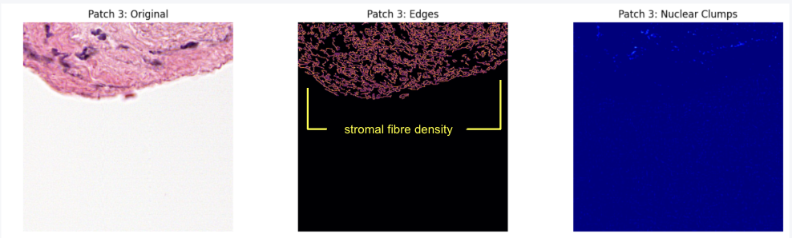
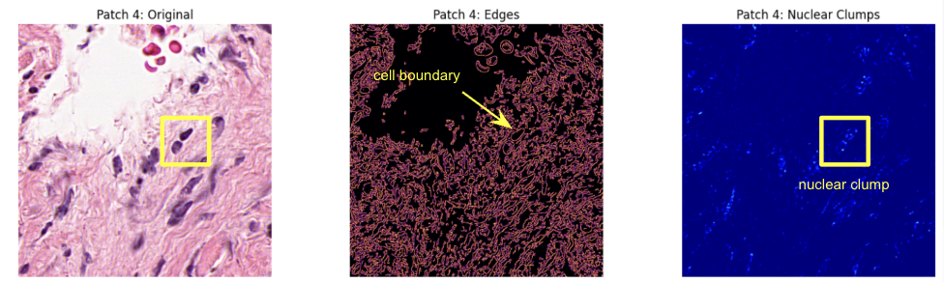
Image Feature Extraction
Feature | Computation | Measures
Img_Nuclear_Density | Mean intensity of the purple channel after Red-channel subtraction (Blue - Red); isolates haematoxylin-stained nuclei | Tumor Cellularity: high density = tightly packed cancer cells
Img_Edge_Complexity | Mean pixel density of the binary output from the Canny Edge Detection algorithm | Tissue Architectural Disorder: High complexity = disrupted architecture = invasive phenotype
Img_Clump_Count | Total count of distinct objects identified via the OpenCV findContours method on a thresholded nuclear map | Nuclear Clustering Behaviour: clump morphology = tumor growth pattern

Slide 11
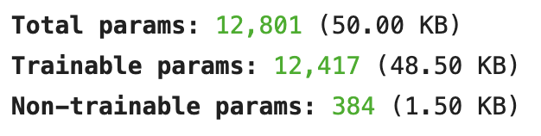
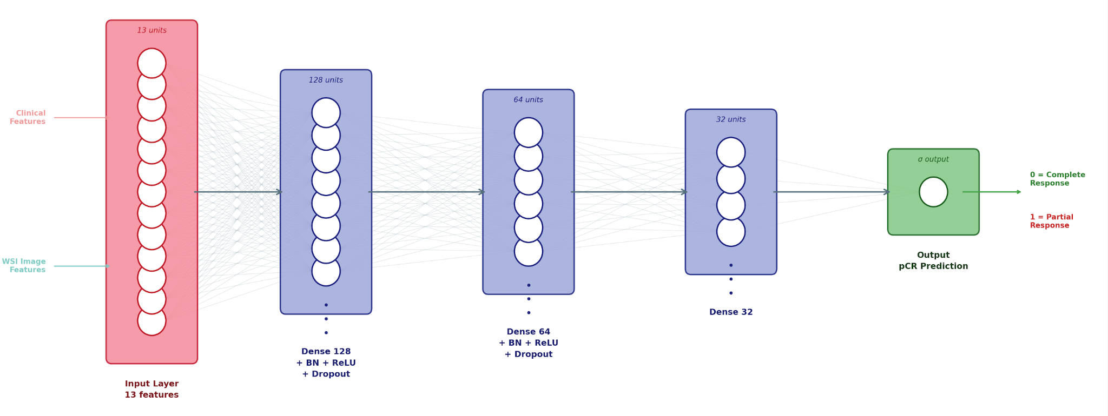
Keras MultiModal Model
Clinical Features
Image Features

Slide 12
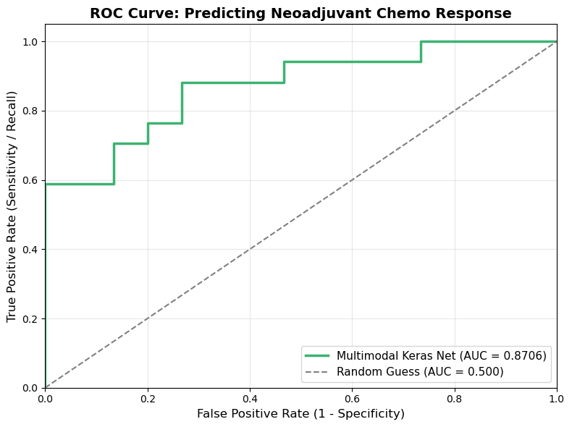
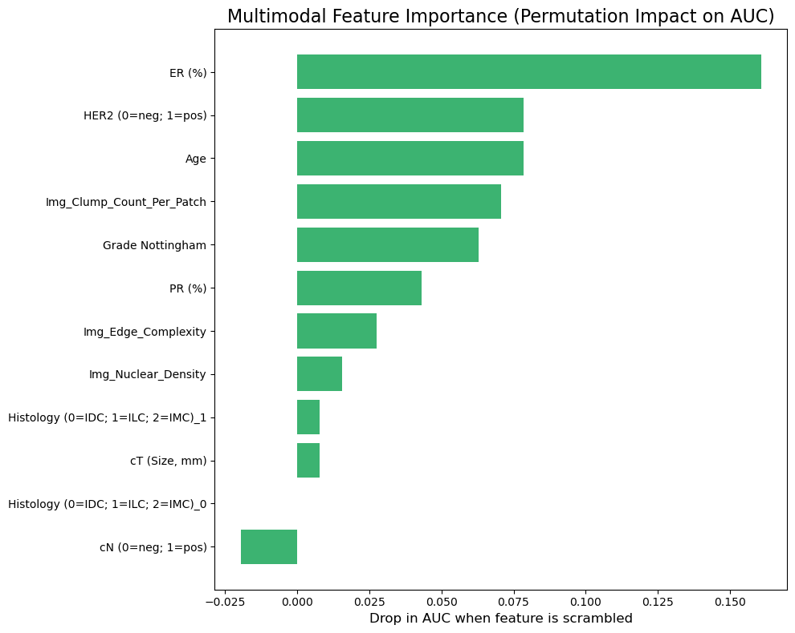
Keras MultiModal Model

Slide 13
Results: Model Comparison
Model | AUC | Accuracy | F1 | Precision | Recall
Clinical Baseline (LR) | 0.833 | 75.1% | 0.775 | 0.782 | 0.773
Clinical Baseline + IMG | 0.852 | 59.9% | 0.664 | 0.790 | 0.812
Clinical + Image (Keras Path) | 0.855 | 78% | 0.78 | 0.82 | 0.78

Slide 14
Clinical Implications
Model Predicts pCR
Model Predicts non-pCR
Proceed with current chemo plan
Patient and doctor gain confidence
Better mental health outcomes
Optimize resource allocation
Switch to a different drug combination
Escalate treatment (add targeted therapy)
Consider skipping to surgery
Enroll in clinical trial early
Key Finding: Luminal A patients had 0% pCR rate — standard NAT may not be the right approach for this subtype. This alone could change clinical decision-making.

Slide 15
Limitations & Future Work
Limitations
Future Directions
Single institution (n=157): small sample
Limited patch sampling from WSIs
No pathology-specific foundation model fully deployed (UNI access pending)
No hyperparameter optimization
Class imbalance within subtypes
No external validation cohort
Use deeper neural network such as PyTorch
Full-slide tiling (300+ patches per patient)
Multi-institutional validation cohort
Survival prediction beyond pCR
Explainability: attention heatmaps on tissue

Slide 16
Limitations & Future Work
Risk Description | Likelihood (1–3) | Severity (1–3) | Total | Rating
Workflow Delay: Clinicians stopping to manually upload biopsy images. | 3 | 1 | 3 | MEDIUM
Overconfidence Bias: Clinicians relying too heavily on the model's output over their own judgment. | 2 | 1 | 2 | LOW
Poor Model Tuning: Inaccurate predictions leading to sub-optimal treatment paths. | 1 | 3 | 3 | MEDIUM
Data Drift: Model performance degrading over time as clinical protocols change. | 1 | 2 | 2 | LOW
Algorithmic Bias: Model performing less accurately on specific demographic subgroups. | 2 | 3 | 6 | HIGH
Notes:
We’ve mapped out our primary risks, for example acknowledging that while workflow delays are likely, they are low severity.
These risks can be addressed through future deliverables such as integrating an automation to pull biopsy images directly from the imaging database, removing the manual upload hurdle

Slide 17
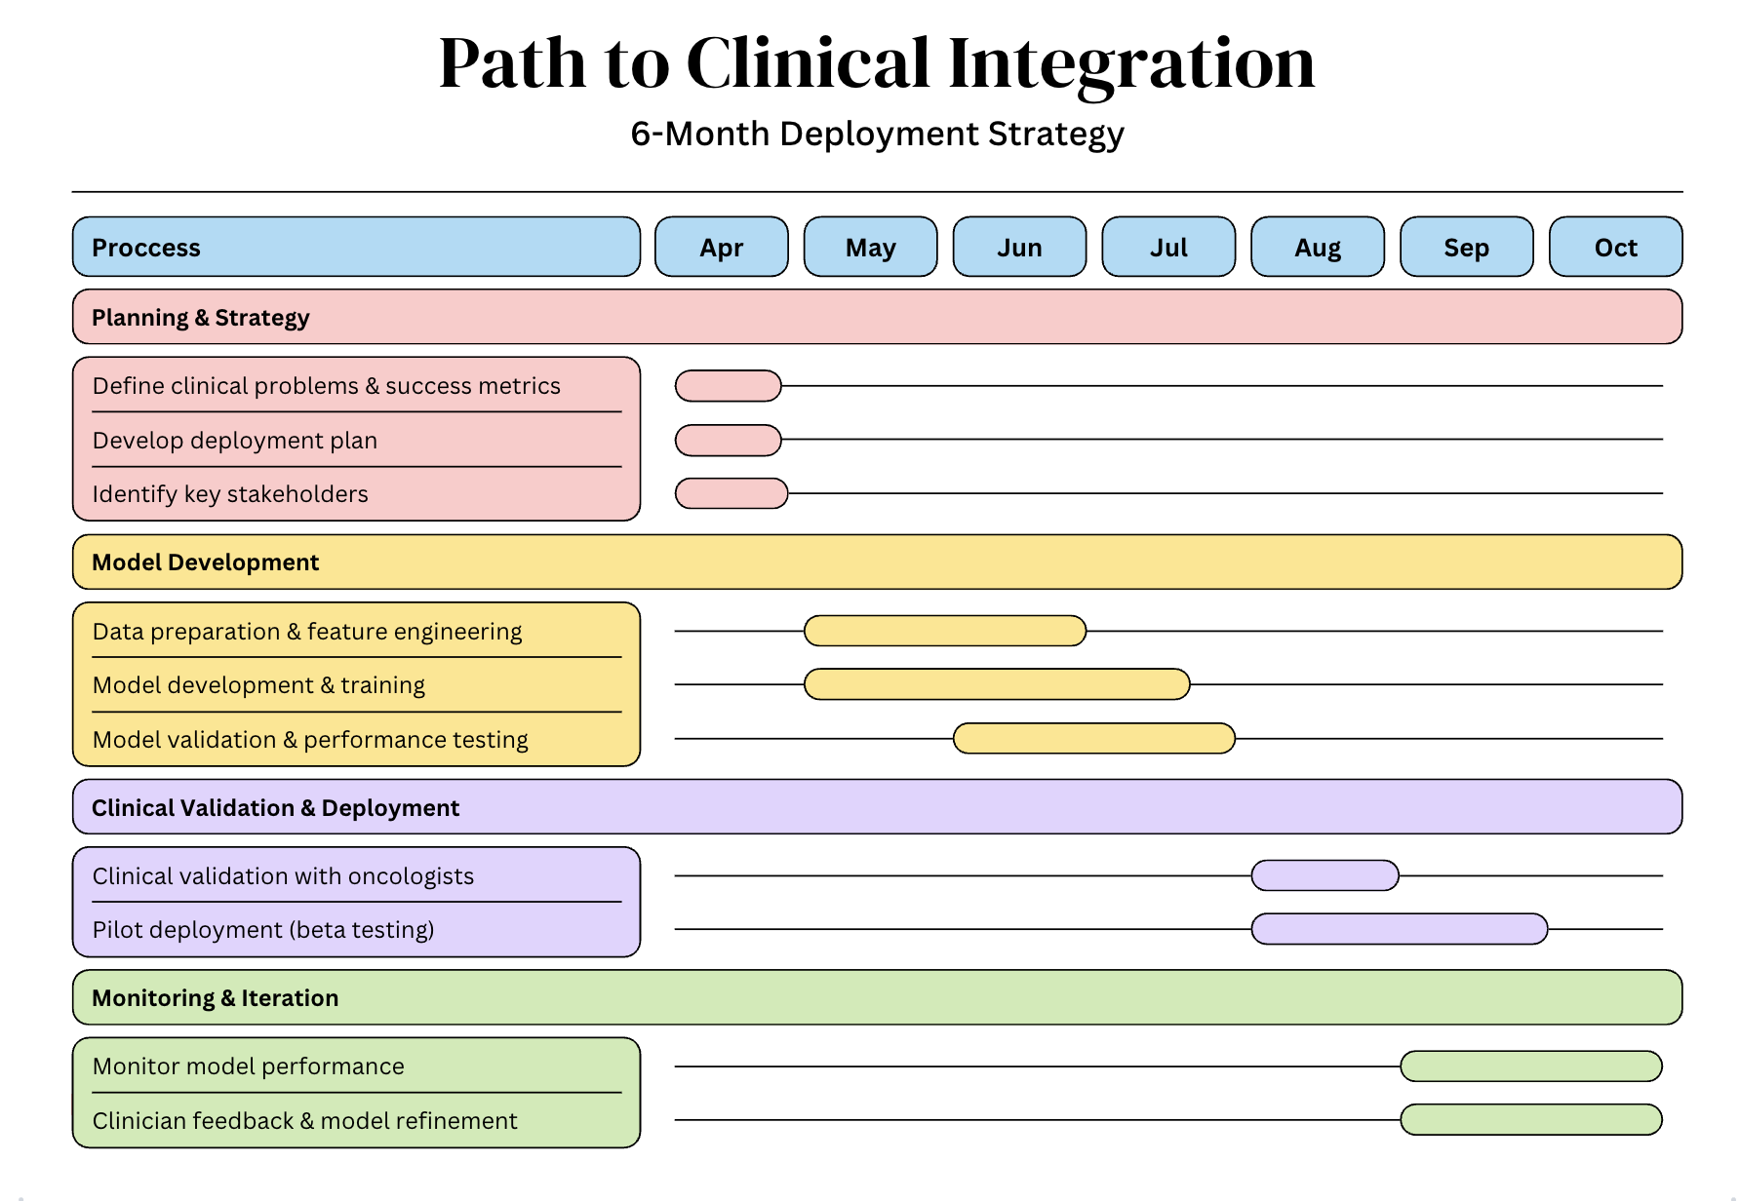
Limitations & Future Work
Notes:
To ensure our model translates into actual clinical impact, we’ve outlined a 6-month deployment plan that moves from technical validation in May to a pilot phase with oncologists by August

Slide 18

Demo

Slide 19

Credits
Thank You

